Slide 1
Middle Housing in [city name]
City of [city name]
[date]

Slide 2
Overview
What is middle housing?
Why is middle housing important?
How will middle housing change my neighborhood?
What is [city name] doing to address housing needs?

Slide 3
Project Background (1)
This meeting is part of a grant-funded project (Washington State Department of Commerce Middle Housing Grant)
Collaboration between Milton, University Place, Fife, Gig Harbor, and Edgewood
These cities are part of a larger housing affordability partnership: South Sound Housing Affordability Partners (SSHA³P)
Notes:
Strike this slide.

Slide 4
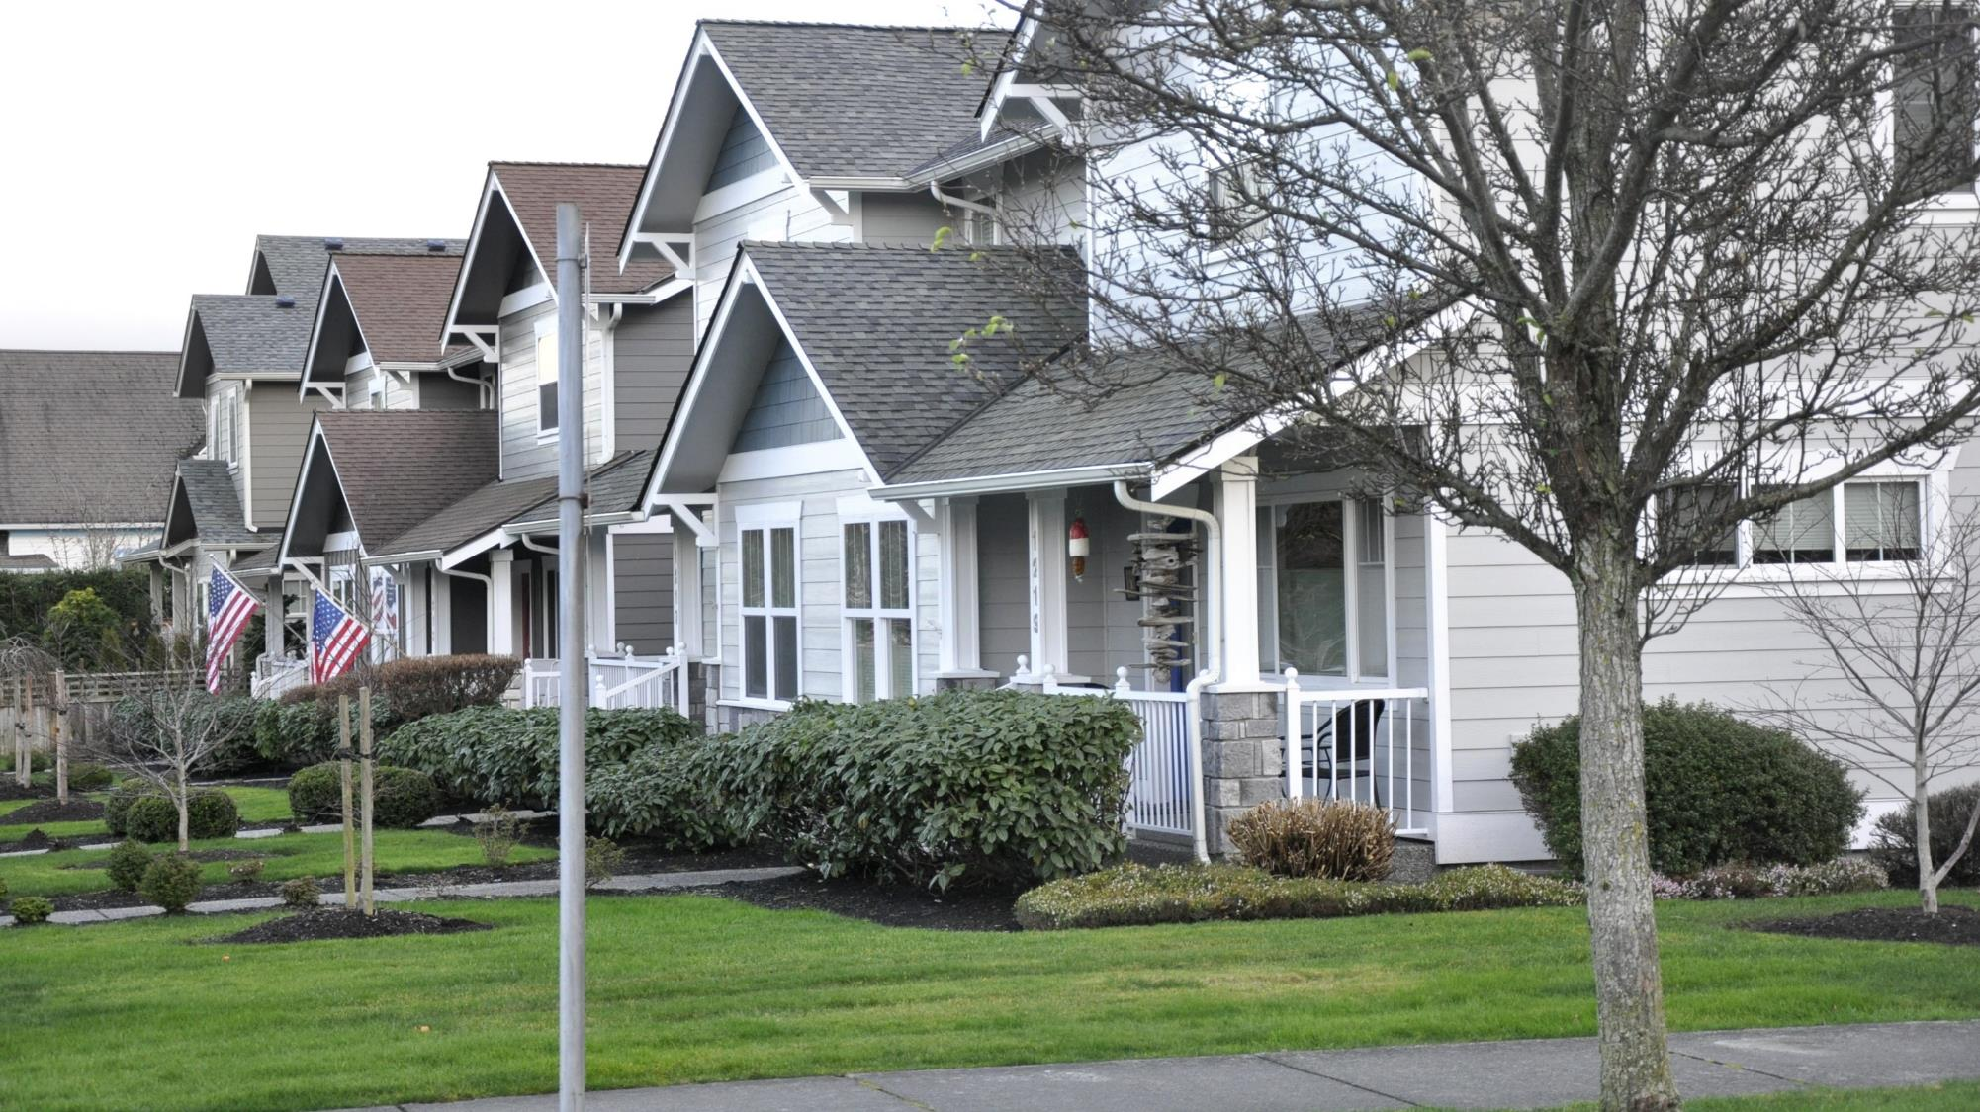
What is Middle Housing?
Image from Sightline Institute

Slide 5
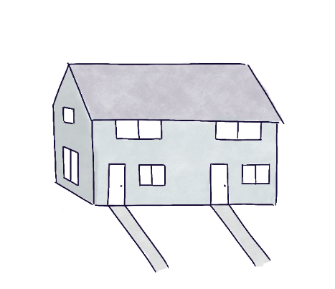
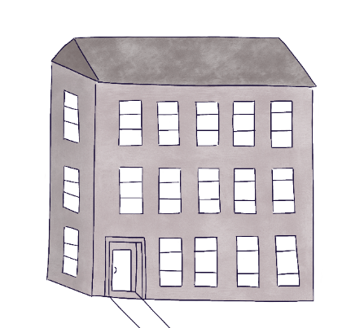
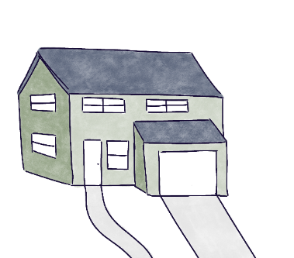
Middle housing is housing that falls between single-family houses and larger apartment buildings.
Single-family housing
Larger units
Low density
More expensive to build on a per-unit basis
MIDDLE HOUSING
Multifamily housing
Smaller units
High density
Less expensive to build on a per-unit basis

Slide 6
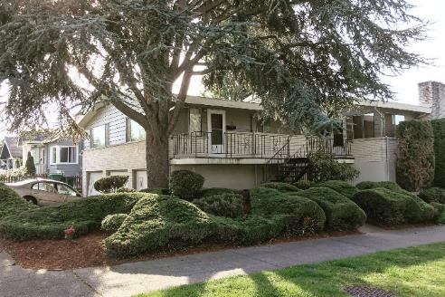
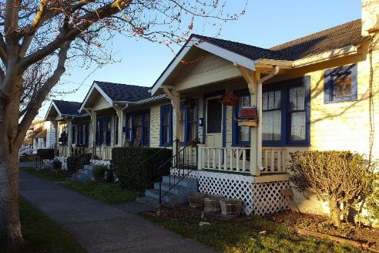
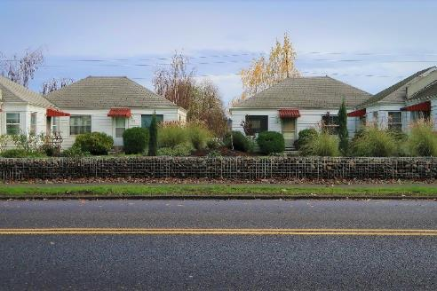
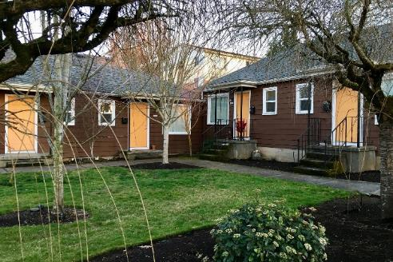
More about middle housing
Townhouses
Duplexes
Triplexes
Fourplexes
Sixplexes
Courtyard buildings
Cottage housing
Live/work lofts
Mother-in-law units / Accessory Dwelling Units (ADUs)
Commonly built in Washington communities until the mid-20th century.
Architectural style, scale, and density of middle housing can be similar to single-family homes.
Promotes more efficient use of existing infrastructure and more walkable neighborhoods.
Examples from Sightline Institute

Slide 7
Why is Middle Housing important?

Slide 8
Middle housing is one of many efforts to address housing affordability in Pierce County.
Housing costs have risen 3x as fast as incomes over the past 10 years
1 in 3 households spend more than 30% of their income on housing
About ½ of renters spend more than 30% of their income on rent
To purchase an average home, you would have to make more than 1.5x the county median income
Notes:
Housing costs have risen 3x as fast as incomes over the past 10 years (2010 – 2011)
Housing Cost Change Income Change Ratio
Edgewood 393% 45% 8.75
Fife 164% 44% 3.68
Gig Harbor 157% 58% 2.70
Milton 101% 34% 2.95
University Place 170% 49% 3.46
Housing Cost Burden (spending more than 30% of income on housing)
Edgewood 34%
Fife 44%
Gig Harbor 46%
Milton 34%
University Place 32%
About ½ of renters spend more than 30% of their income on rent
Edgewood 9%
Fife 17%
Gig Harbor 16%
Milton 25%
University Place 14%
Median Income Buyer Index (The median income household has XX% of the income necessary to buy a house at the current median selling price) (2022 Q3) (WCRER) https://wcrer.be.uw.edu/housing-market-data-toolkit/affordability-index/
Edgewood 79
Fife 69
Gig Harbor 55
Milton
University Place 62

Slide 9
Middle housing serves housing needs not met by single-family homes or large-scale multifamily development.
Young families
Single households
First-time homebuyers
Older adults
Multigenerational households

Slide 10
Because we have different housing needs throughout our lifetime.
Middle housing can benefit everyone in our community.

Slide 11
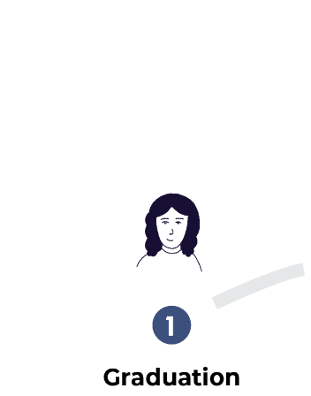
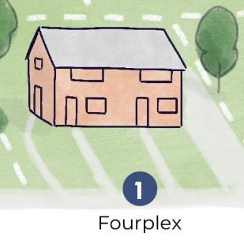
Housing needs change over the course of our lives.
Single-family home
Single-family home
Notes:
Perhaps make the top line – Housing needs change over the course of our lives.

Slide 12
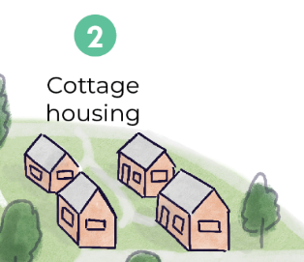
Housing needs change over the course of our lives.
Single-family home

Slide 13
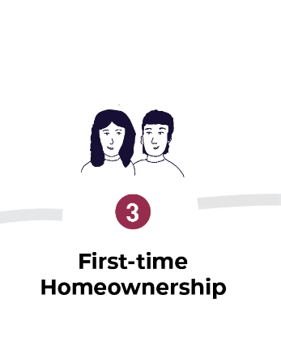
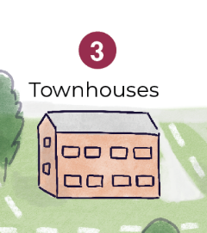
Housing needs change over the course of our lives.
Single-family home

Slide 14
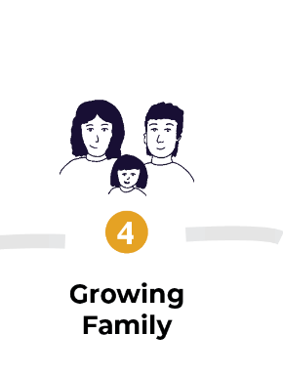
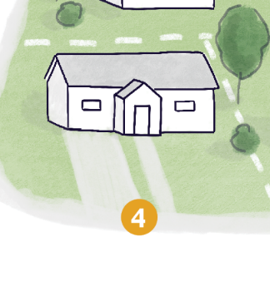
Housing needs change over the course of our lives.
Single-family home
Notes:
#4 isn’t labeled

Slide 15
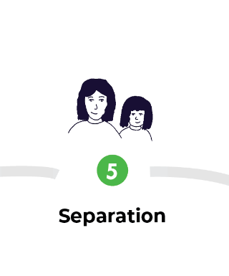
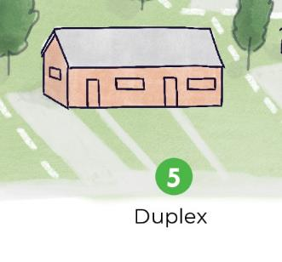
Housing needs change over the course of our lives.
Single-family home

Slide 16
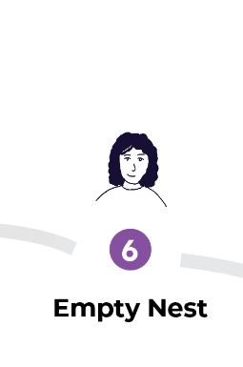
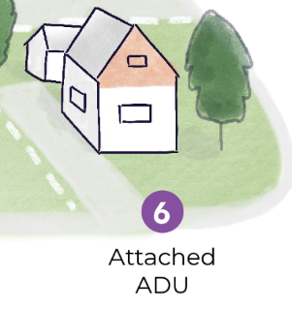
Housing needs change over the course of our lives.
Single-family home

Slide 17
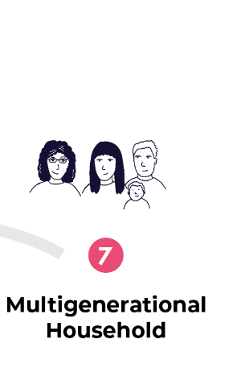
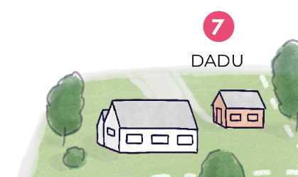
Housing needs change over the course of our lives.
Single-family home

Slide 18
Housing needs change over the course of our lives.
Single-family home
Single-family home

Slide 19
Allowing middle housing is an important strategy to increase housing options.
It is hard to predict the future, but we know what the market is currently producing.
Middle Housing enables a variety of household types to find suitable homes in the community.
Middle Housing options can offer homeownership opportunities, particularly entry level homeownership.

Slide 20
All types of housing will be needed to make housing more affordable.
Local government does not build housing, it establishes rules on what can be built and where.
Current regulations prevent homebuilders from innovating in response to market demand.
Housing growth has not kept up with job growth: the solution is more housing.
Source: Zillow
$872,500 ($286/s.f.)
3,054 s.f.
3 bedrooms
13,503 s.f. lot
Built in 2022
$369,000 ($279/s.f.)
1,319 s.f. each
2 units with 3 bedrooms
12,632 s.f. lot
Built in 2020
$398,000 ($372/s.f.)
1,068 s.f.
2 bedrooms
3,367 s.f. lot
Built in 2020

Slide 21
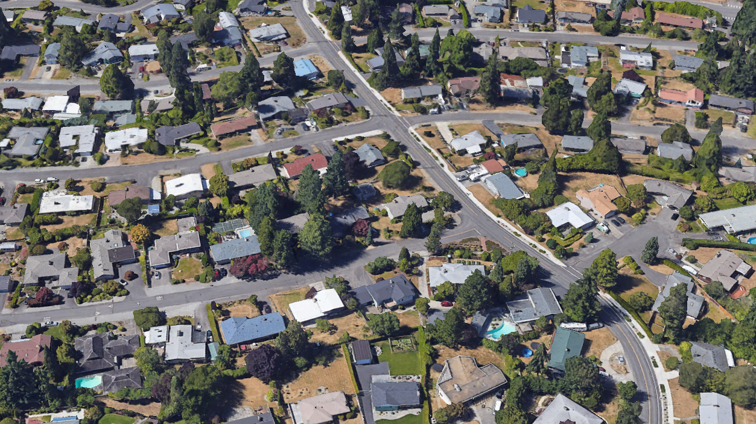
How will middle housing change my neighborhood?

Slide 22
Neighborhoods have changed and will continue to change.
Neighborhoods are meant to change as community needs change.
Development standards regulate development on topics like parking requirements, building height, setbacks, impervious surfaces, and architectural design.
Where middle housing is allowed, it must still meet city development standards.

Slide 23
Current single-family neighborhood.

Slide 24
A building is replaced, another modified.

Slide 25
Continued change over time.

Slide 26
Increased variety over time.

Slide 27
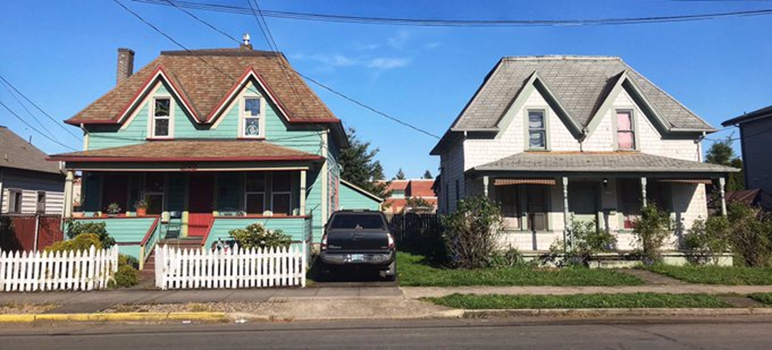
Allowing middle housing doesn’t necessarily change the scale of buildings that can be built.
Some middle housing types can be a similar building size as single-family houses
Cities can use development regulations to control for height, setbacks, design, etc.
TWO HOMES
ONE HOME
Example from Portland, Oregon

Slide 28
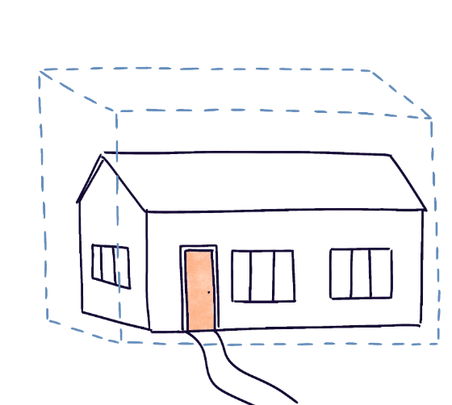
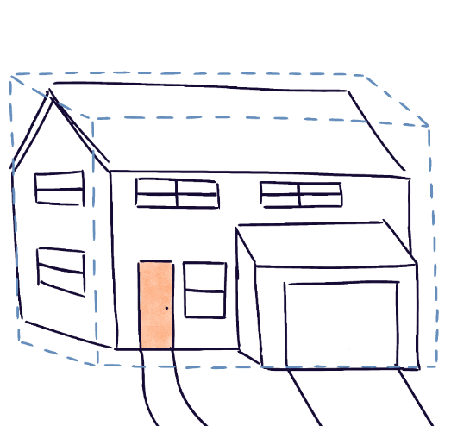
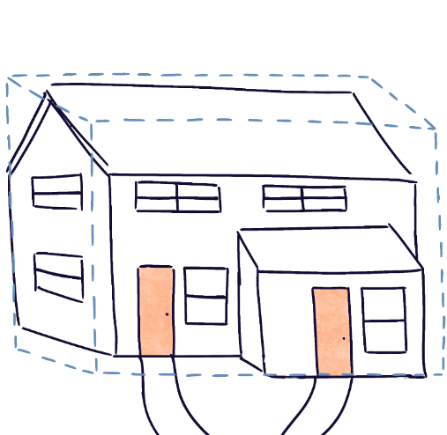
Existing homes in your neighborhood are likely smaller than the maximum size allowed. Whether middle housing is allowed or not, bigger buildings will likely be developed.
Many existing houses, especially older homes, are smaller than the development code allows.
Single-family homes have become larger over time. When new houses are built, they are often built closer to the maximum size allowed.
Allowing missing middle housing does not change size maximums but allows more than one unit in the same space.
Currently allowed
Allowing middle housing will create more housing options

Slide 29
Communities that have allowed middle housing have seen incremental change
Cities that have legalized middle housing types have increased the variety of new housing, though only modest upticks in number of middle housing units.
Most of the new housing is still single-family or apartment units.

Slide 30
Allowing middle housing will not necessarily increase property values.
Property values are based on your land, structure(s), and market conditions.
Allowing missing middle housing is associated with potential land value increases on lots that are suitable for redevelopment.
Reinvestment into existing neighborhoods can improve the infrastructure for everyone, including sidewalks, transportation improvements, neighborhood-based services.
New investment into development and amenities will increase property values.
Washington State and Pierce County offer property tax relief programs to senior citizens, disabled persons, households with limited income, widows, and widowers of veterans.
Households at risk of losing their home due to property tax increases may be eligible for property tax exemptions or relief.

Slide 31
Allowing middle housing will not necessarily increase property values.
Property values are based on your land, structure(s), and market conditions.
Allowing missing middle housing can increase land value for lots that are suitable for redevelopment.
Households at risk of losing their home due to property tax increases may be eligible for property tax exemptions or relief.
Washington State and Pierce County offer property tax relief programs to senior citizens, disabled persons, households with limited income, widows, and widowers of veterans.
Reinvestment into existing neighborhoods can improve the infrastructure for everyone, including sidewalks, transportation improvements, neighborhood-based services.

Slide 32
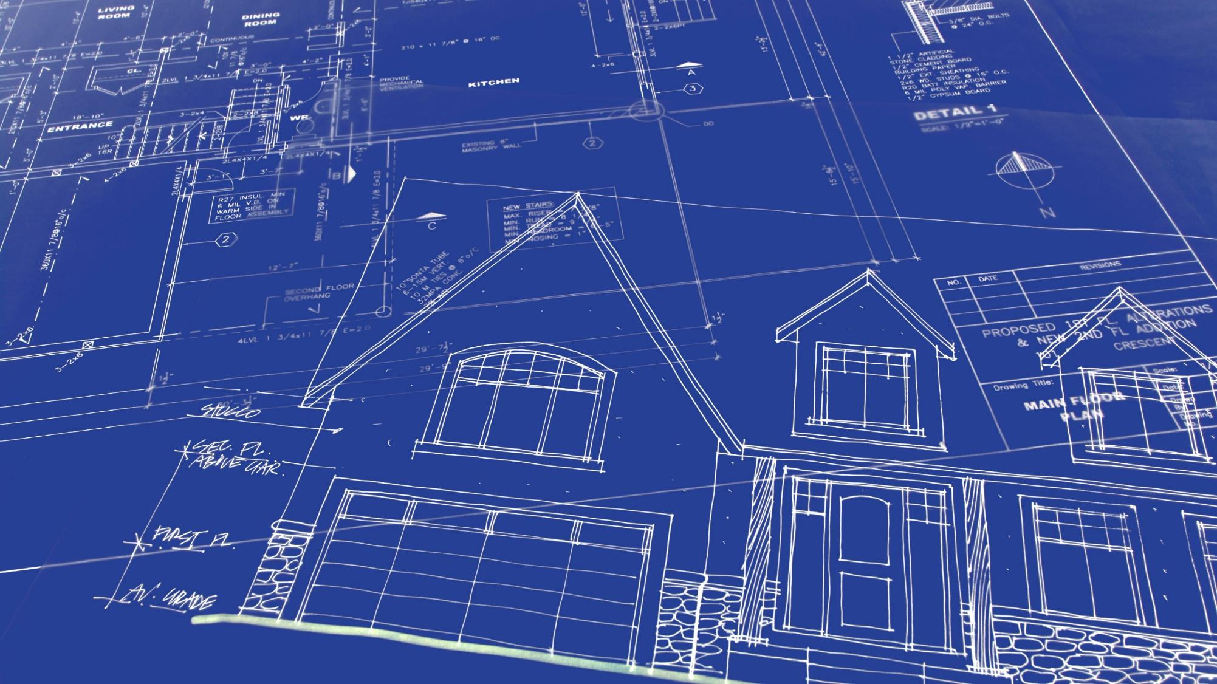
What is [City Name] doing to address housing needs?

Slide 33
SSHA³P Middle Housing Study
[City] is collaborating with other cities and the South Sound Housing Affordability Partners (SSHA³P) to address housing needs in Pierce County.
Several cities received a grant to study areas most suitable for middle housing.
The City will use this information to inform potential updates to development regulations and zoning.
Middle housing must still meet city development standards such as parking minimums, impervious surface limits, height limits, and setbacks requirements.
Placeholder for map of the city

Slide 34
What happens next?
The city is updating its comprehensive plan for 2024.
The comprehensive plan sets the vision and policies for the city over the next 20 years.
New state law (passed in 2021) requires cities to allow greater housing diversity in existing neighborhoods.
Place holder for City’s Timeline

